Slide 1


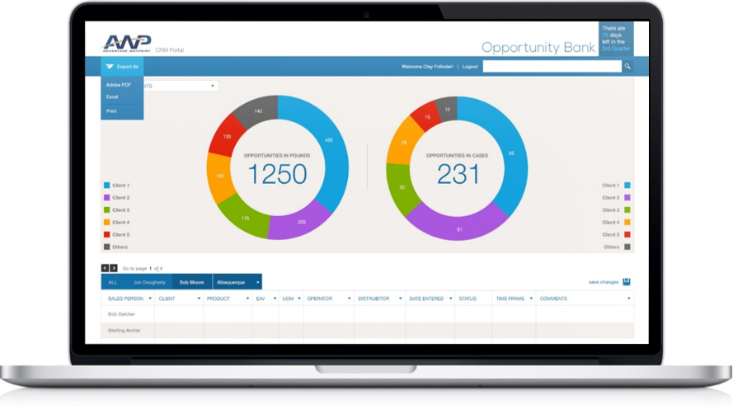
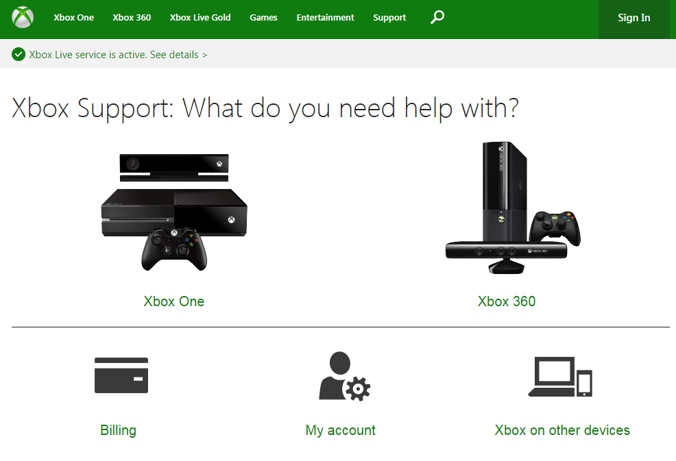
Xbox Customer Support / Ambassadors – Managed Service
Business Need
Customer Support Portal – support.xbox.com – conversion of legacy system to modernized website and self-service experience.
CRM Implementation – Case Management & escalation process
Design & Implementation of Xbox Ambassador program on Azure
Integrations – Integration Development between membership databases, social media platforms, and disparate data sources
Business Intelligence – Reporting and Data Visualization development for a variety of business units and stakeholder groups.
Team Size: 30
Locations: Seattle & India
Duration: August 2015 to Present
Industry: High Tech Gaming
Ongoing Partnership
25-30 full-time resources across development, support, leadership.
Integrated agile project management processes and platforms
Full augmentation of application development, business support, and various business processes across multiple stakeholder groups.

Slide 2
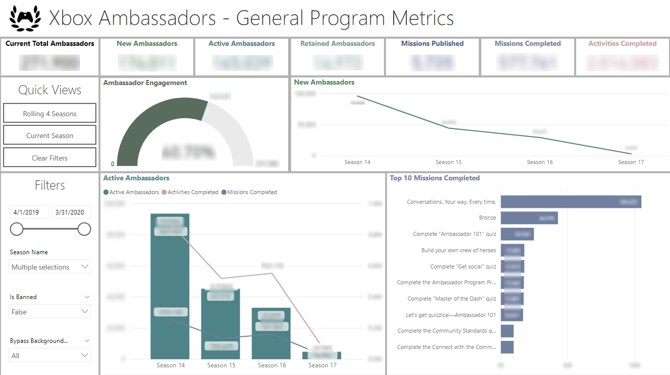
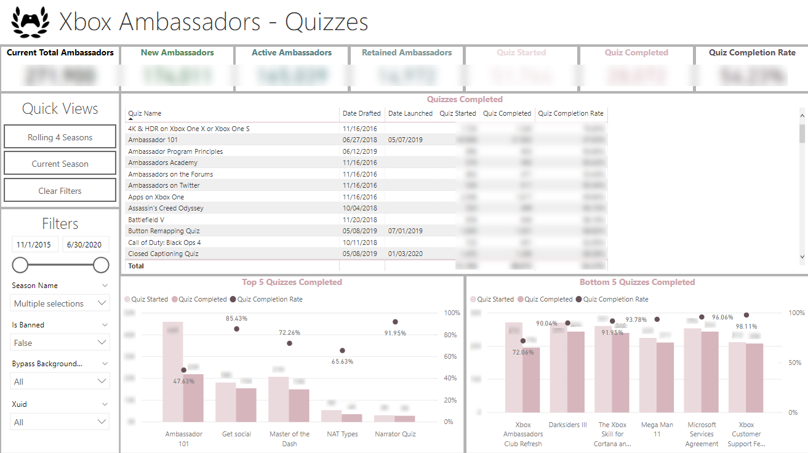
Xbox Ambassadors – Power BI Details
Power BI built using Kusto data source with billions of records.
Telling the story of how many users and what kind of activity they have achieved on their gamified site.
Includes Adobe Analytics connection for site statistics.
Ongoing engagement with support and quarterly additions .

Slide 3

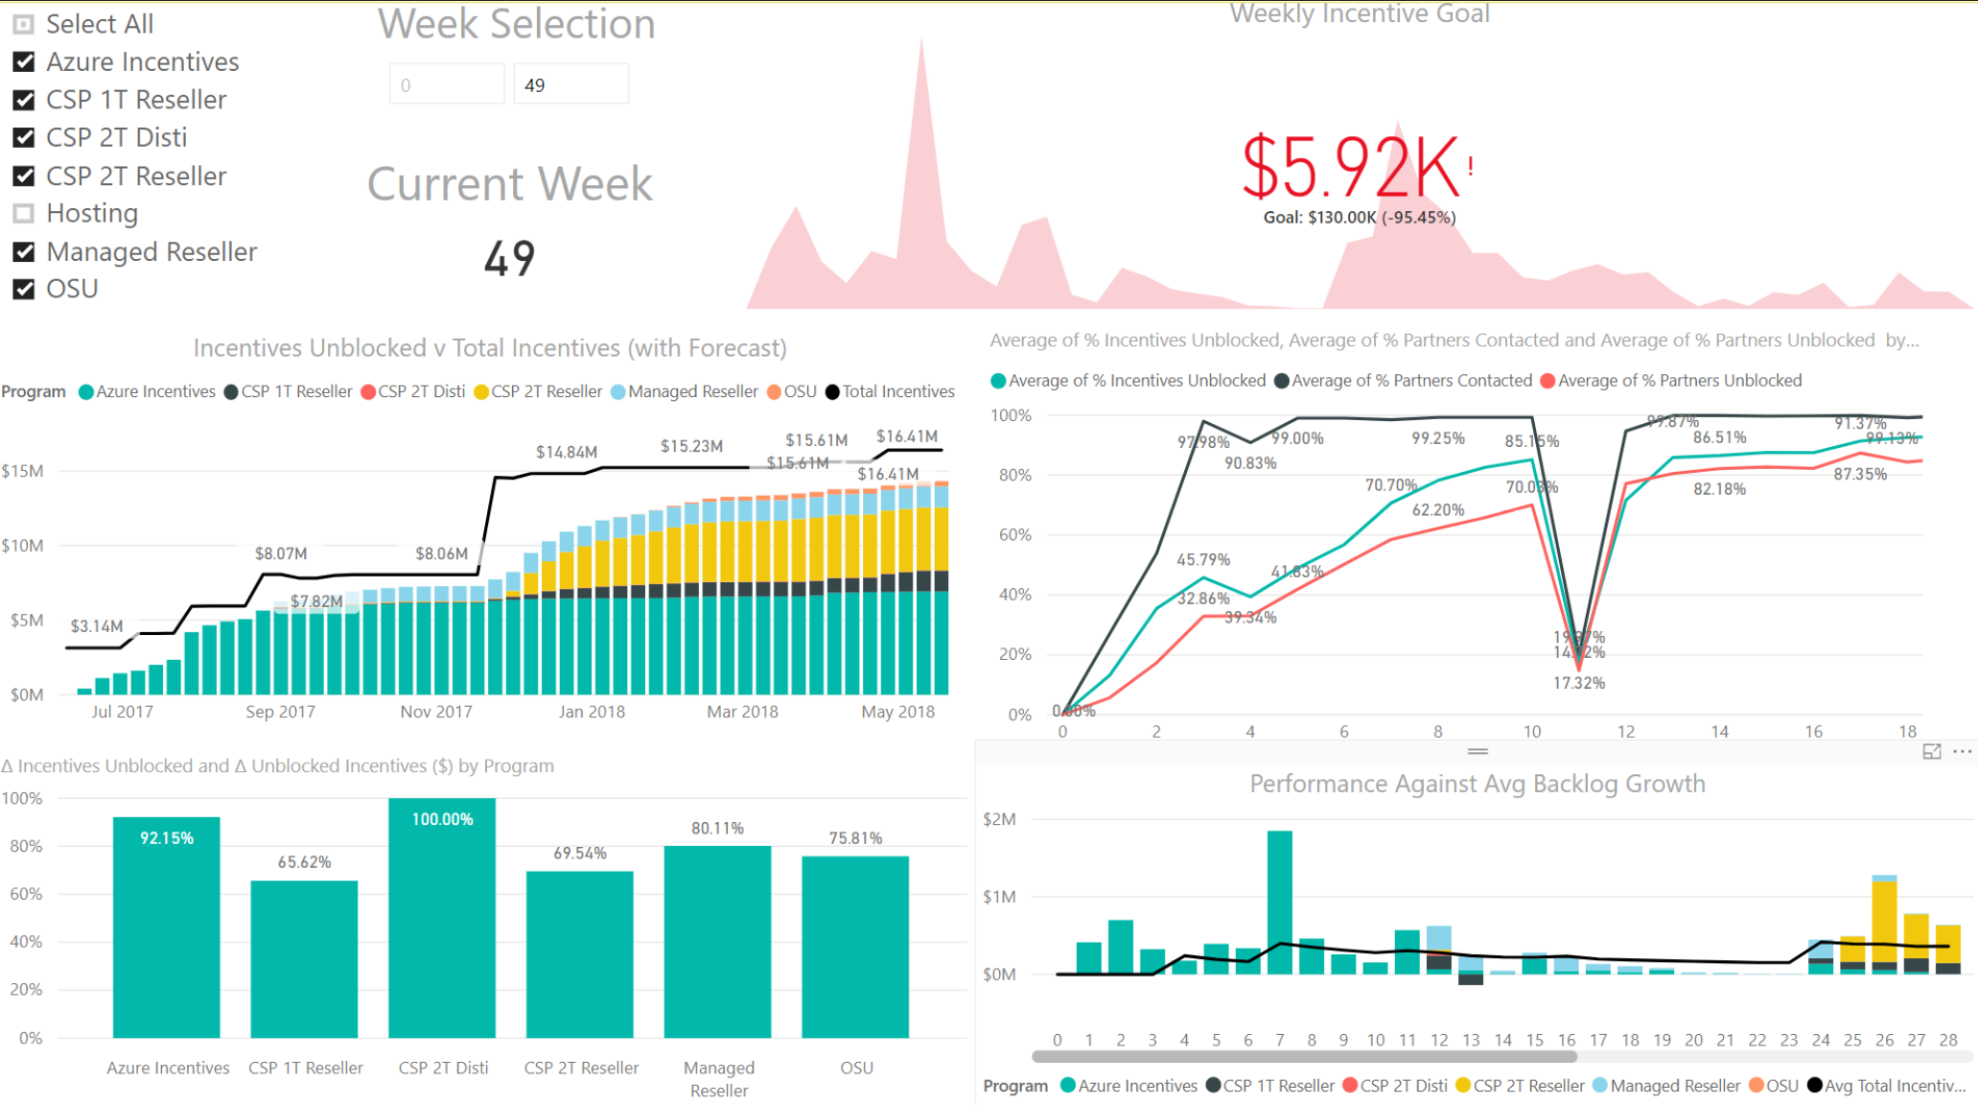
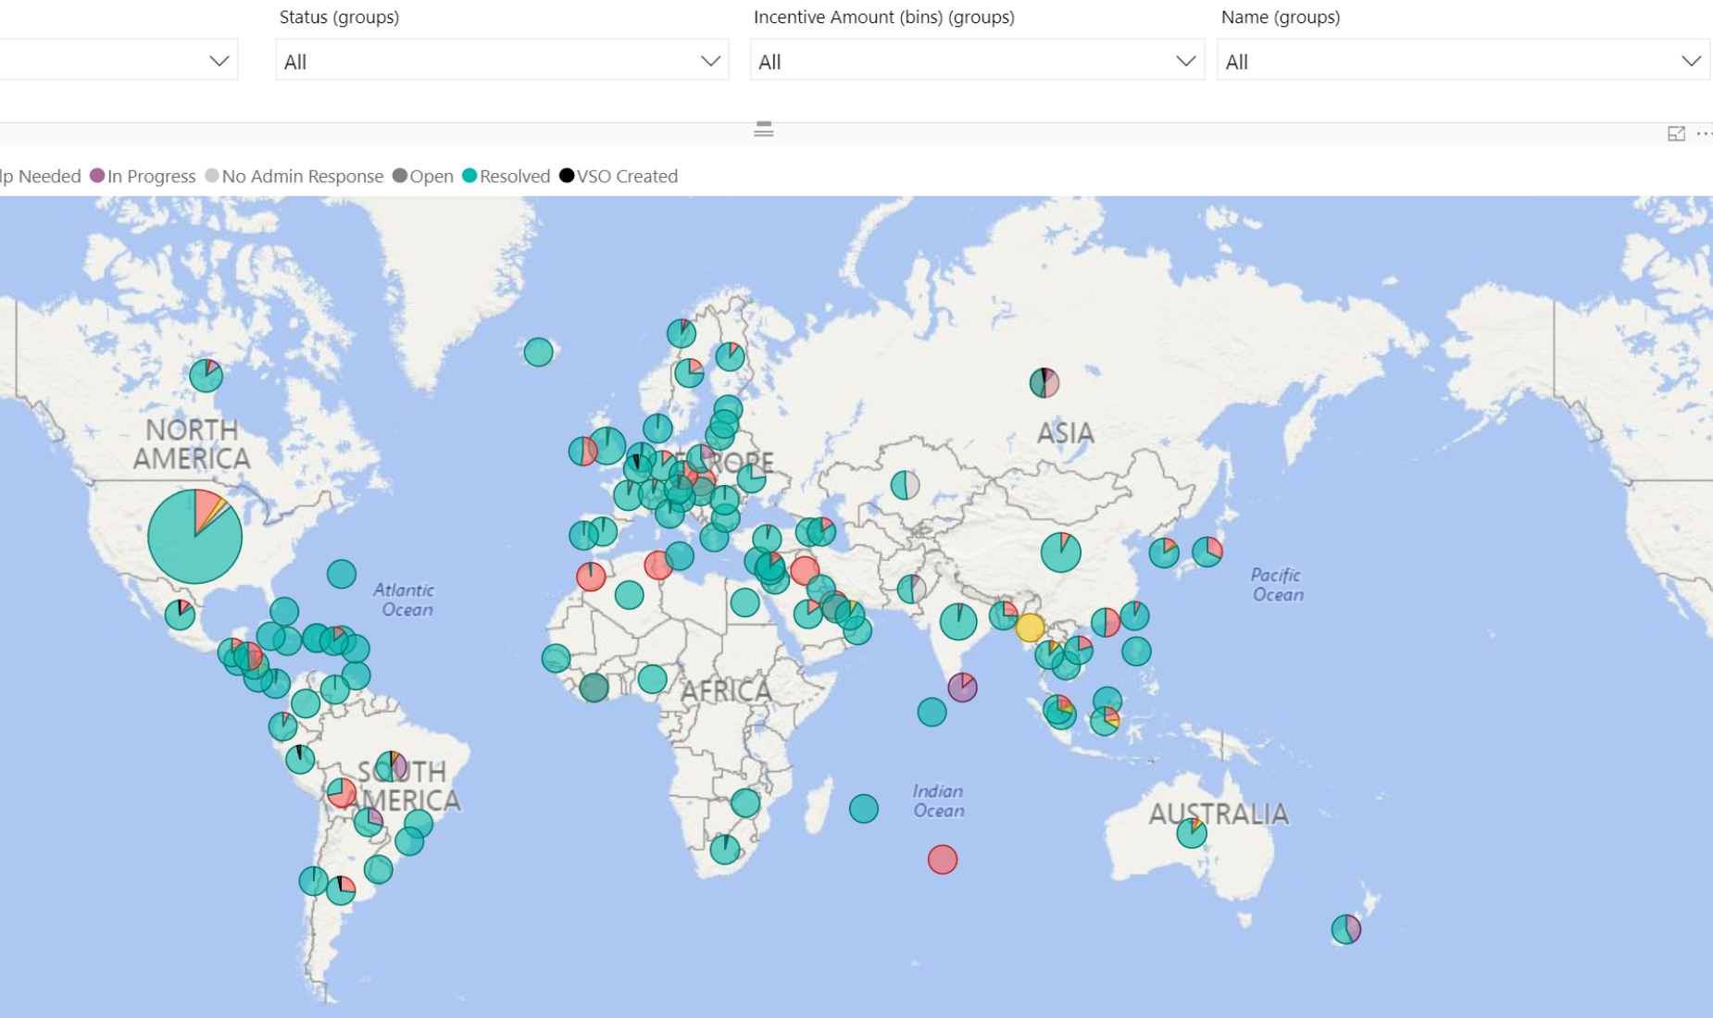
Microsoft – Xbox PowerBI Samples

